Slide 1

LLM Debug And Evaluation

Slide 2
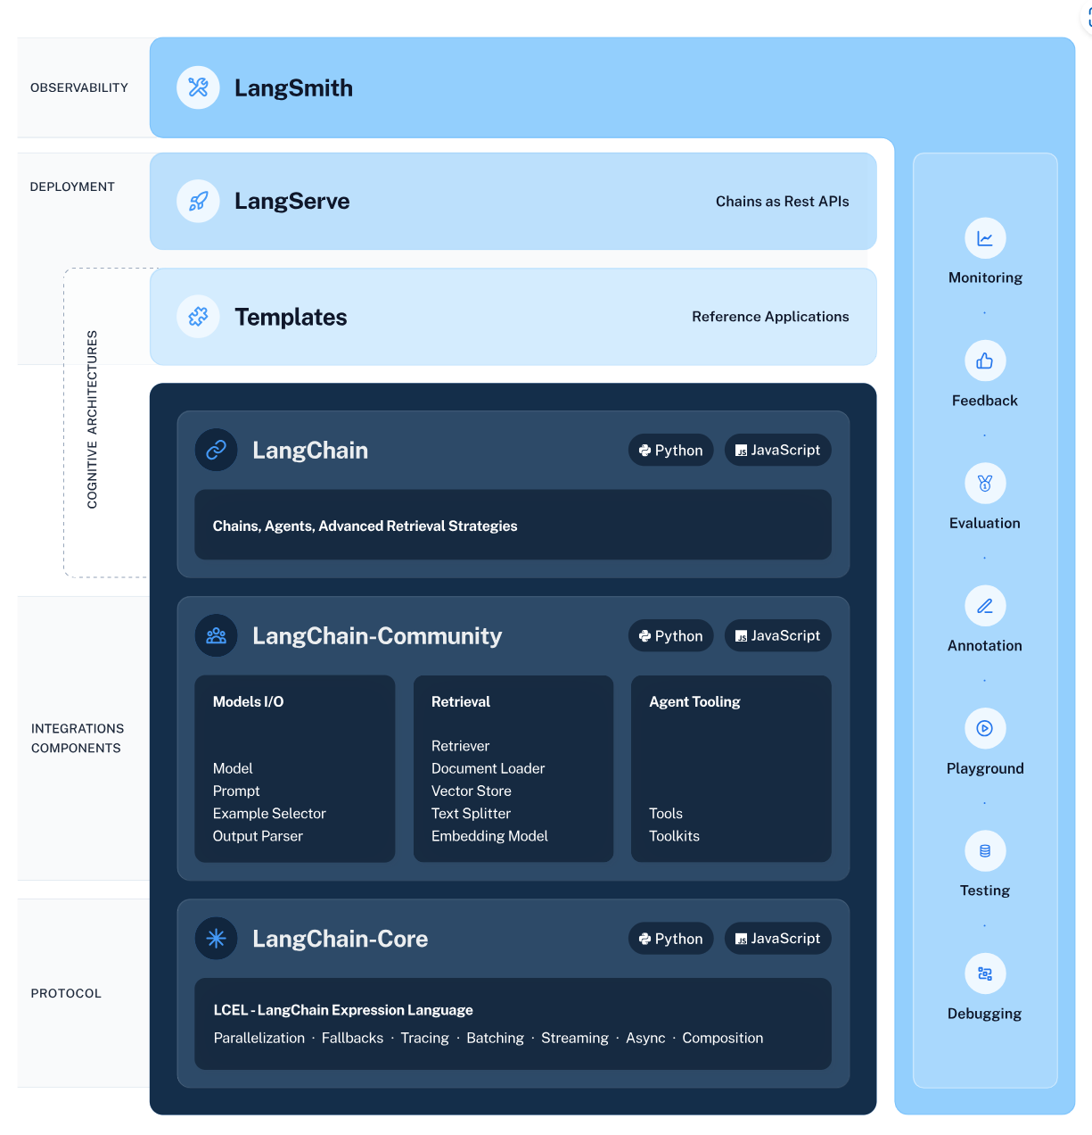
Langchain framework

Slide 3
WHY ?
Non-deterministic Outputs
API opacity
Security
Bias
Cost
Latency

Slide 4
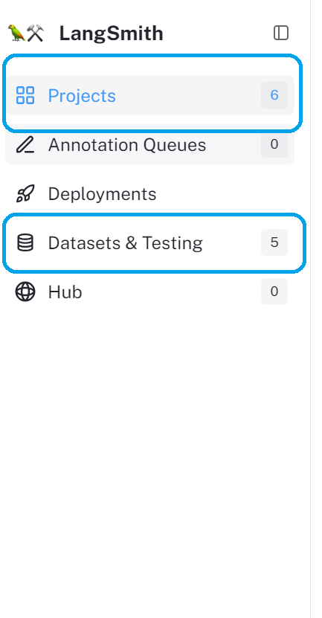
Langchain Overview

Slide 5
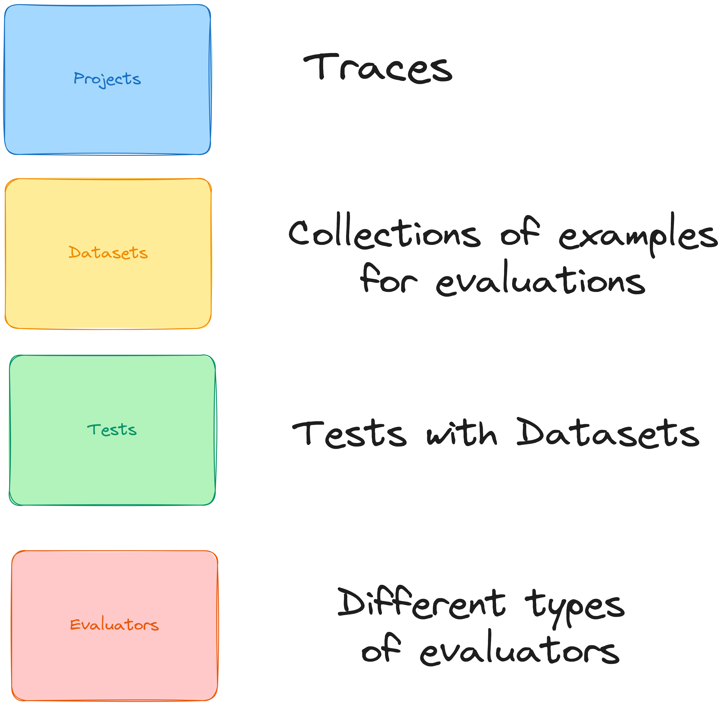
DICTIONARY

Slide 6
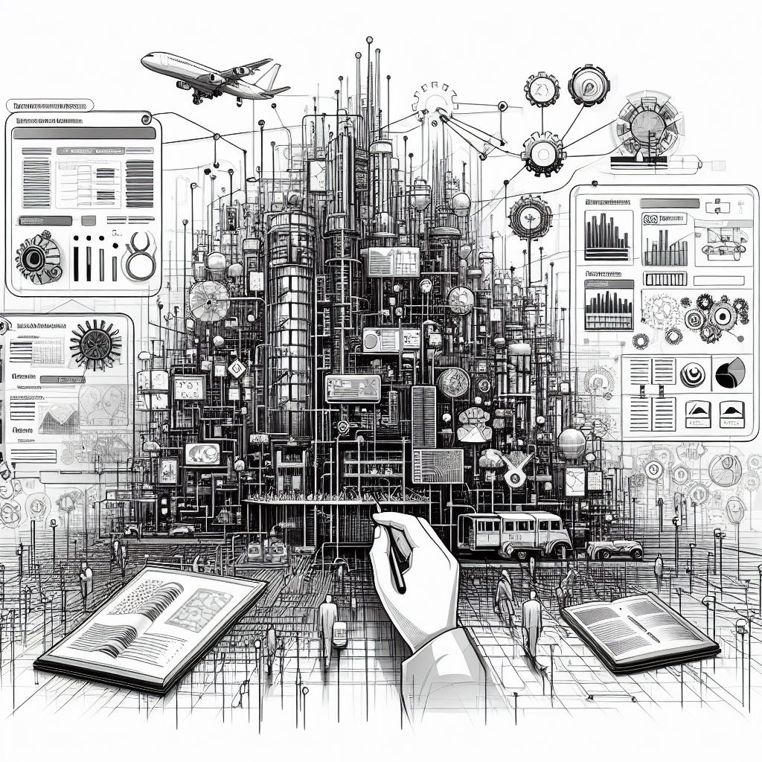
FIRST HANDS-ON EVALUATIONS

Slide 7

RAG EVALUATION

Slide 8
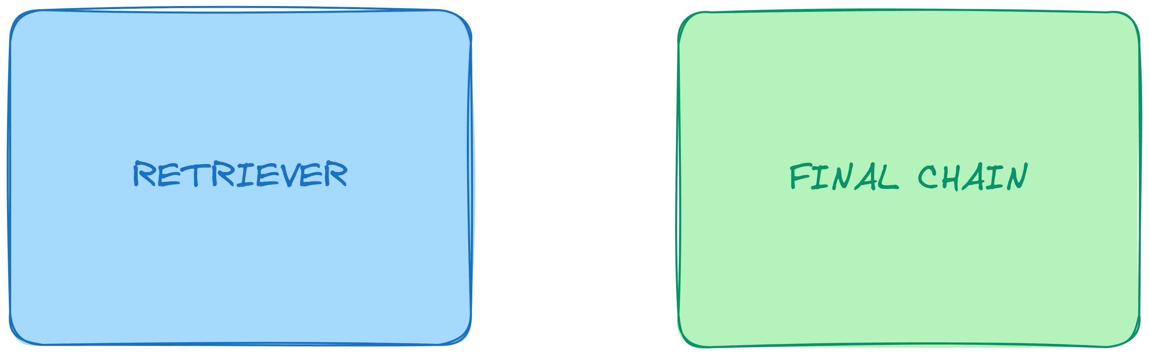
COMPONENTS INVOLVED

Slide 9

HANDS-ON RAG EVALUATION

Slide 10

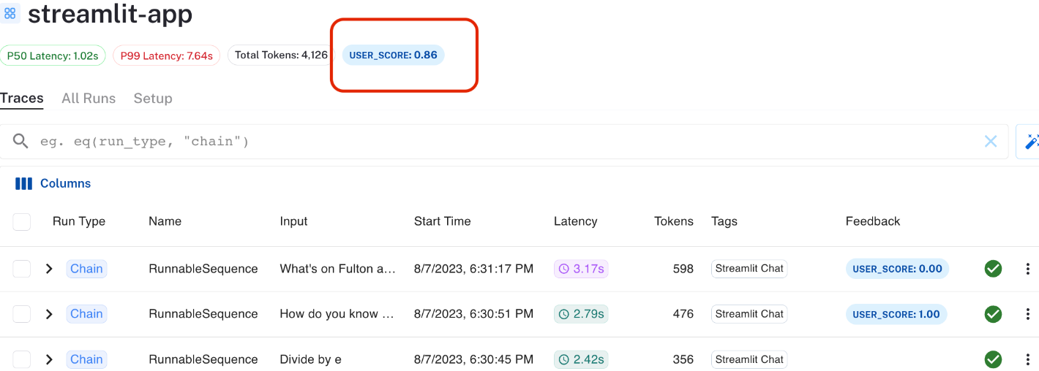
USER FEEDBACKS
Or the “tricky” copy button ;)
Collect User Feedback in Streamlit | 🦜️🛠️ LangSmith (langchain.com)

Slide 11


RAGAS

Slide 12
RAGAS

Slide 13


https://github.com/NTTLuke/genai-articles/tree/experiments/community

Slide 14
References
Prompt Engineering Guide
Introduction | 🦜️🔗 Langchain
LlamaIndex 🦙 0.9.39
Azure AI Search - Generative Search | Microsoft Azure
The vector database to build knowledgeable AI | Pinecone
Chroma (trychroma.com)
Advanced RAG Techniques: an Illustrated Overview – Towards AI
Must see videos
A Survey of Techniques for Maximizing LLM Performance (youtube.com)
https://www.youtube.com/watch?v=zjkBMFhNj_g&t=2396s (Andrej Karpathy)

Slide 15


‪‪❤︎‬
01011
Love, Code and Play

